Slide 1
Exploratory Data Analysis (EDA) Telco Customer Churn
MA

Slide 2
Analysis Objective Dataset Information Data Preprocessing
Findings in EDA Deep Dive EDA Conclusion
Outline

Slide 3
The analysis aims to understand why customers decided to stop using the telco service.
In detail, I look for:
Demography characteristics’ in relation to churn variable
Services used by customers in relation to churn
Deep dive into demography characteristics and services to find the reasons to stop using the service
Analysis Objective

Slide 4
The dataset contains information as in the following.
Dataset Information
Features |  |  | Target
Customers’ demography | Telco Services | Related to contract | Churn
Gender Senior citizen Partner Dependents Tenure | Phones service Multiple lines Internet service Online security Online backup Device protection Tech support Streaming tv Streaming movies | Payment method Paperless billing Contract | Churn

Slide 5
Data Cleaning
In the process of cleaning data, my findings are:
Missing values are found only in totalcharges. The variable’s type is still an object, but due to missing value, it cannot be convert to integer. After removing the missing values which were 11, the variable can be converted to int.
No duplicates
Data Preprocessing

Slide 6
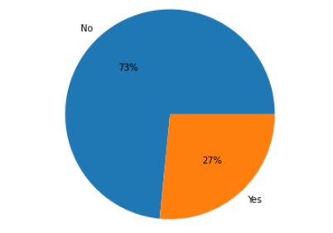
Findings
Churn Rate is pretty high, reaching 27% or equivalent 1899
Churn yes
Churn no

Slide 7
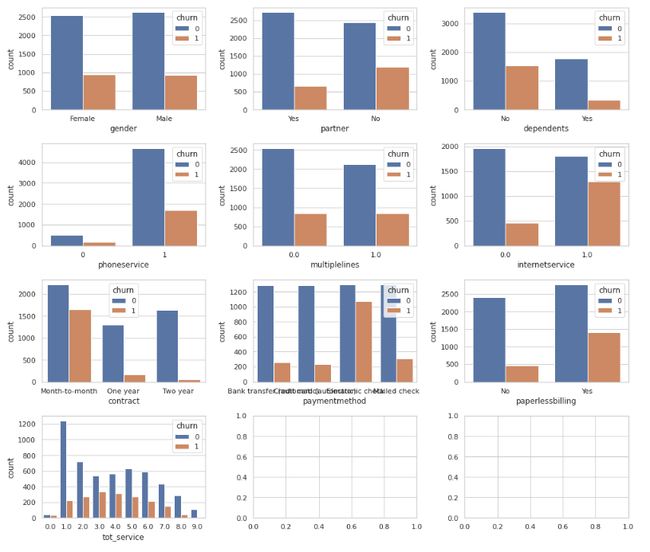
Findings: Customers’ Characteristics
Customers who stop using the service have characteristics as follows:
No partner
No dependents
Contract on a month-to basis with paperless billing
Use bank transfers and check as the payment method
Use many services (more than 3)

Slide 8
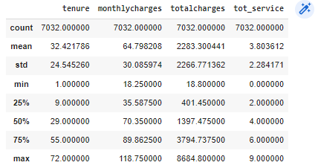
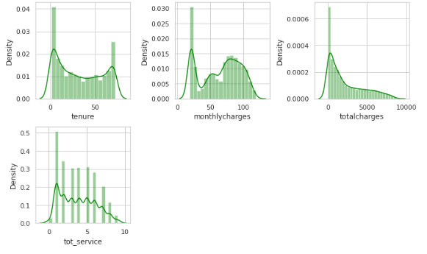
Findings: Summary Statistics
The summary statistics show that the variables are not normally distributed. The Kernel distribution also shows similar result. However, we consider this as normal, and thus proceed the process

Slide 9
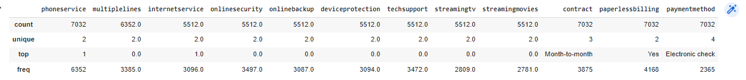
Findings: Summary Statistics
Services that are used the most are phoneservice and internetservice

Slide 10
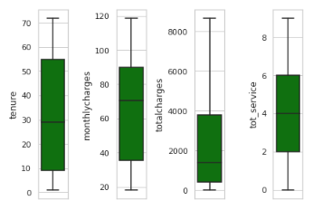
Findings: Univariate Analysis
No outliers

Slide 11
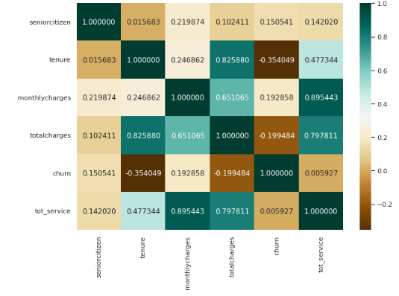
Findings: Correlation
tot_service and monthlycharges, as well as tot_service and totalcharges have a strong correlation, which is reasonable
totalcharges and tenure also have pretty high correlation
interestingly, churn has a negative and mild correlation with tenure

Slide 12
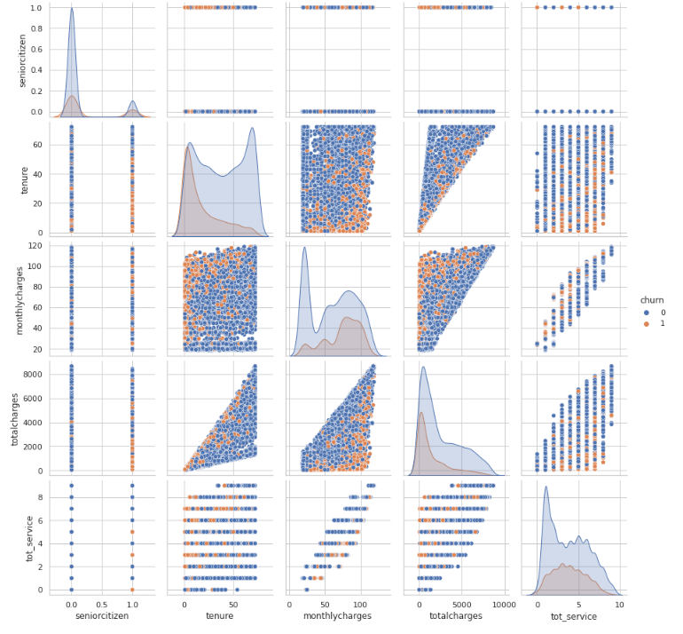
Findings
I used churn as the hue parameter to explain the reasons people stop using the service
It seems customers who stop using the service are likely to be a senior citizens with relatively short years of working and relatively high bills

Slide 13
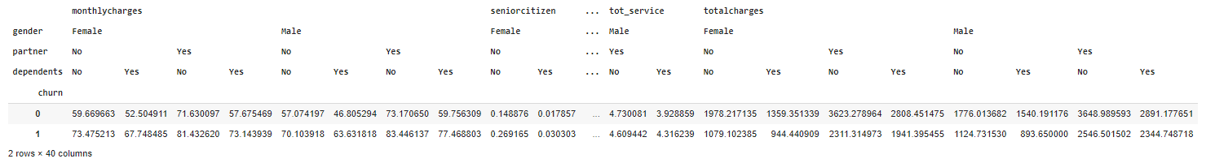
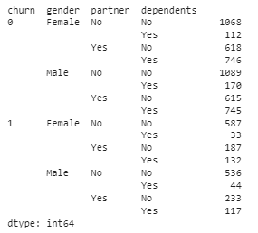
Deep Dive
Across characteristics, those who stop using the service have relatively higher monthly bills and shorter years of tenure, ni partner, and have relatively higher monthly charges than those who keep using the service.

Slide 14
Conclusion & Recommendation
Conclusion
Our findings suggest that the characteristics of customers who stop using the service are:
No partner
No dependents
Contract on a month-to basis with paperless billing
Use bank transfers and check as the payment method
Use many services (more than 3)
In addition, customers who stop being loyal have relatively higher monthly bills and shorter years of tenure and have relatively higher monthly charges than those who keep using the service.
Recommendation
Develop a contract method or service package that is in line with the needs of young customers
In addition, careful to offer services other than telephone and internet service to young customers
Improve the payment method, aiming to provide a payment method that is less hustle for customers

